Slide 1
Timely, reliable service to your clients
Increase profits for your business

Slide 2
Service Goals
To increase bottom-line profitability in your practice
Offer clients and their pets additional in-house services at your familiar practice
Successful, positive outcome solutions to surgical cases presented in your practice

Slide 3
Services Provided
Highly-desirable surgical services
Select orthopedic and soft tissue cases
Positive, high success outcome
Additional alternative to referral
Surgical services only
So your practice profits from additional peri-operative requirements
Anesthesia
Boarding
Pharmaceuticals

Slide 4
Profitability Analysis
Procedure | Cost of Procedure | You Earn
TPLO cruciate repair | $2600 | $1200
Congenital Patellar Luxation | $1200 | $600
Femoral Head And Neck Ostectomy | $1300 | $650
Sample Month
Procedure | # | Gross Profit
Extracapsular cruciate repair | 2-3 | $2400-3600
Congenital Patellar Luxation | 2-3 | $1200-1800
Femoral Head and Neck Ostectomy | 1-2 | $650-1300
Total | 5-8 | $4250-6700

Slide 5
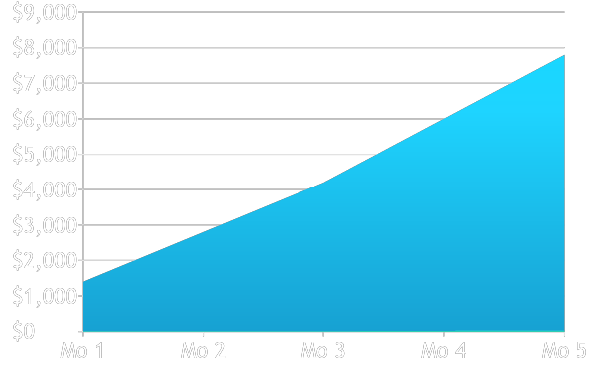
Profitability Over Time – TPLO Cruciate Repair

Slide 6
Profitability Analysis - TPLO cruciate repair
Procedure | Extracapsular Cruciate Repair
Surgical Fee | $1450
Radiographs | $350
Anesthesia | $400
Peri-operative pharmaceuticals | $400
Total | $2600
Surgery Fee | $1450
Other | $1150
10 cases @ $1150 | $11500
20 cases @ $1150 | $23000

Slide 7
Summary
Opportunity to provide additional, highly desirable in-house services for your clients
Opportunity to add significant bottom-line profitability
No additional expenses or personnel required
Opportunity to retain case continuity
Opportunity to obtain specialty surgeon necessary to offer select surgical procedures at your own practice

